Slide 1

CF Project H&H Plays
Hasan Zahid and Hashir bin Asad
01-131232-028 and 01-131232-030
Teachers: Dr. Joddat Fatima and Engr. M Waleed Khan
Dept of SE, BUIC

Slide 2
Introduction
Our aim was to create a web application that connects likeminded gaming enthusiast, mainly PC gamers, on a single platform where they can interact with each other in our forums section, be up to-date on the latest developments in Tech industry from our blogs and have a marketplace to buy and sell PC parts and accessories.
In short, our main purpose was the social connectivity of likeminded enthusiasts and to build a community.
Our Solution was an HTML 5 based custom platform to bring together the PC gamers of Pakistan.
Inspiration:
PPG (Facebook community)
PCMR
Pakwheels.com

Slide 3
Workload Distribution
Hasan Zahid (028)
Concept
Content
Documentation
Hashir bin Asad (030)
HTML
CSS
JavaScript

Slide 4
An Overview
Methods Used
A combination of HTML 5, CSS and JavaScript.
Functionality Developed
Navigation buttons for different sections
Member Login

Slide 5
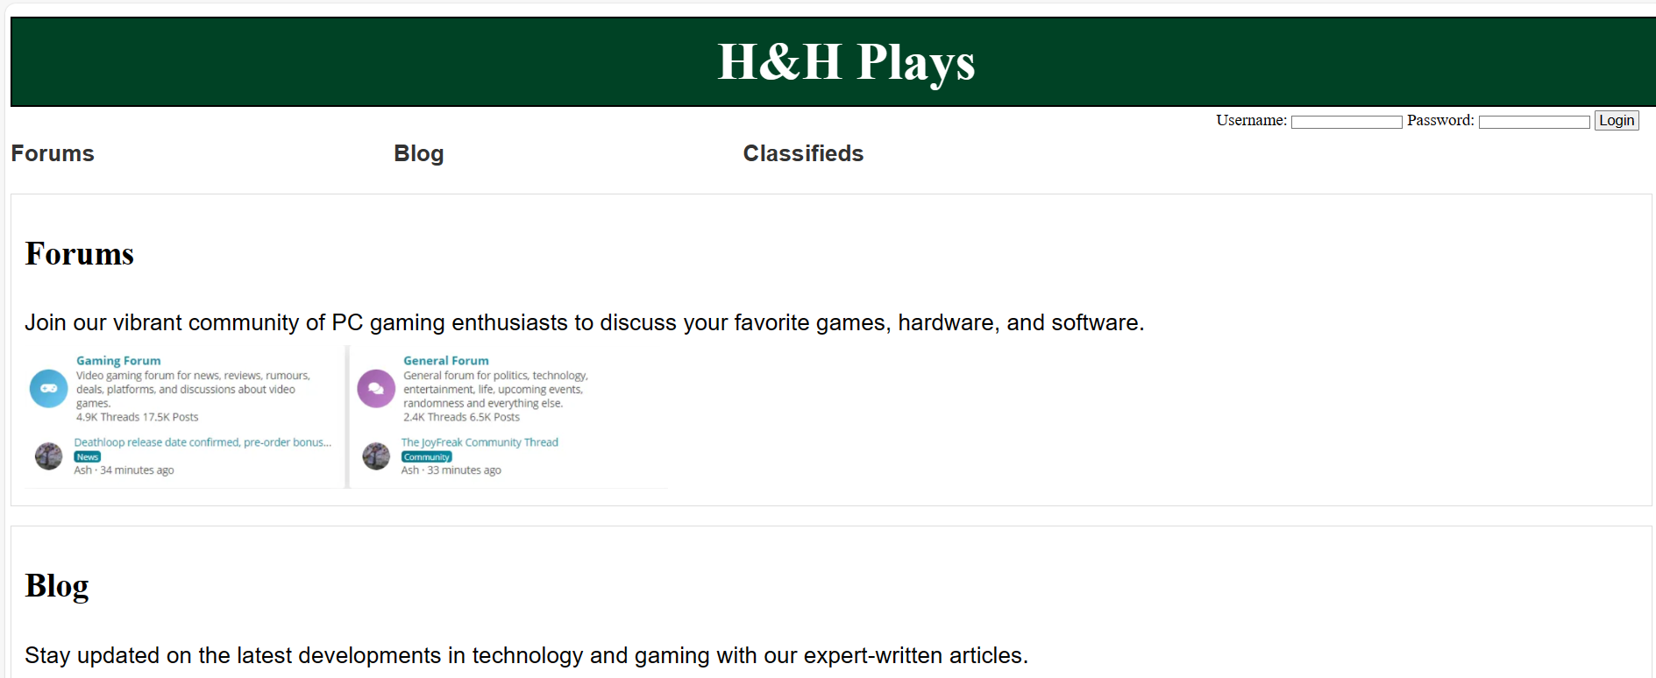
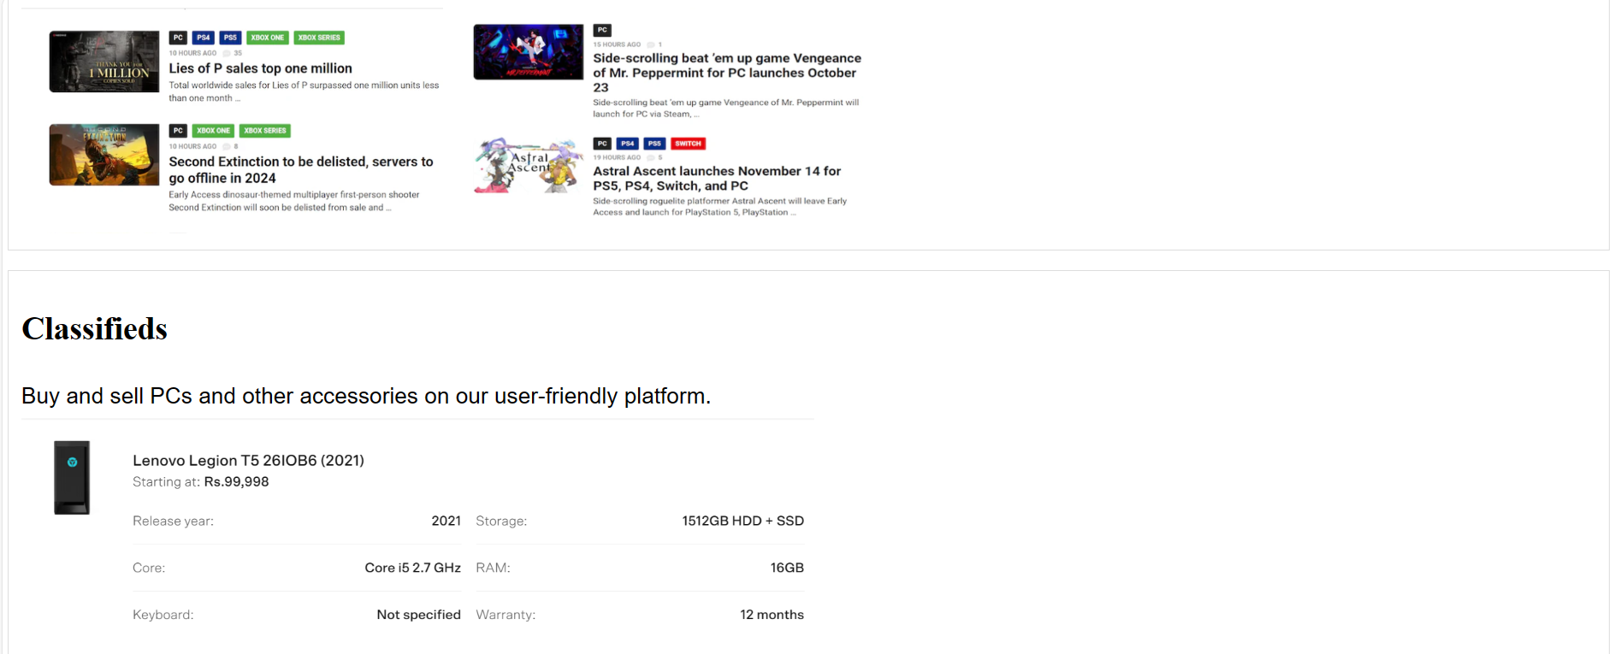
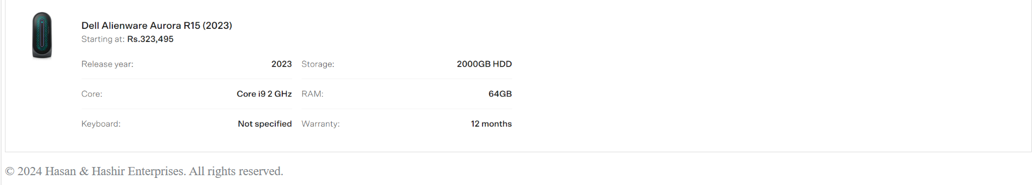
Our Webpage
On the top under the header there are 3 navigation buttons to forums, blog and classified sections.
Then on the right-hand side under the header there is the member login.
The rest of the page is the overview of each section

Slide 6
Conclusion
What we felt as easiest
What was the most difficult
The content gathering and concept.
HTML 5
JavaScript

Slide 7
What Would we Have done differently
Proposed Changes
Further implementation of our different sections.
Add a section for game mods.
Add an e-store that provides video games directly from developers at discounted rates.
Can they be implemented?
Yes, a back-end server will be required for further implementation.
Yes, a game mod section can be easily added.
An e-store would require us approval from banks and different payment institutions to enable purchasing from our site.

Slide 8
Final Comments
H&H Plays presents a comprehensive plan to address the needs of PC gaming enthusiasts in Pakistan and contribute to the growth and mainstream integration of PC gaming in the country. Furthermore, the awareness regarding latest trends and news in technology will be ensured. We look forward to seeing a growing wave of like-minded people on this platform. This platform is also expected to be maintained/moderated by team of dedicated individuals who are passionate about gaming and technology. The moderation team will play a crucial role in ensuring an inclusive environment for all users, encouraging healthy discussions and interactions within the community.

Slide 9
Thank You
Link to web-app: H&HPLAYS.com

